Slide 1
Street Automation

Slide 2
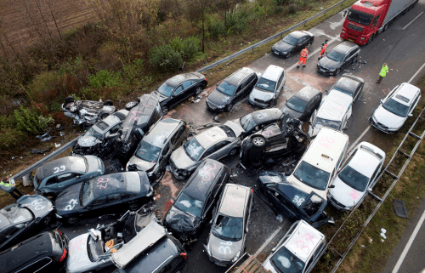
Real-world problem

Slide 3
Components
Arduino UNO R3
Photo resistor (LDR)
IR tracker sensor
RGB LED module
Simple LEDS
Button

Slide 4
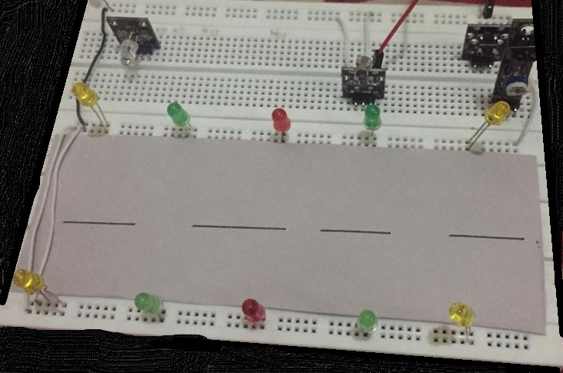
TIME FOR DEMO

